Slide 1
Rotary Youth Driver Awareness Project COIT20273: Software Design and Development Project
Project Members:
Bijay Shahi (12021856)
Keshav Khadka (S0280624)
Pratik Shrestha (S0282733)

Slide 2
Project Objectives
Develop a interactive and informative three-tiered software application that allows the students to take a quiz or a survey on road safety awareness.
The system allows students to:
Attempt quiz questions with multiple choices
View the results of their attempts
View the right answers for the questions
Review their performances
And allows administrator to:
Create/read/update/delete quiz questions
View the report of quizzes undertaken by students

Slide 3
Project Constraints
Scope
The project will cover the overall initial expectations as mapped in system requirements.
Time
The project is expected to be aligned with the deadlines of milestones and report submission due dates as per the unit profile of the course COIT20273.
Cost
The only cost for the project is the labour hours of the team members dedicated to the project.
 | Time | Scope | Cost
Constraint | 
Enhance
Accept |  |  | 

Slide 4
Hardware and Software requirements
Platform: J2EE platform
Server: Glassfish 4.1.1 or above (open source)
Database server: Embeded Derby (open source)
Operating system: Windows server 2003 or above, Linux server
Development tool: Netbeans (IDE)
Project Professional 2016 for WBS
MS Visio, Draw.io for Use case, Database design

Slide 5
Work Breakdown structure

Slide 7
Milestones
Milestones | Deadlines
Project plan submission | 28/07/2017
Progress report 1 submission | 04/08/2017
Requirement specification submission | 11/08/2017
Progress report 2 submission | 25/08/2017
Design document submission | 25/08/2017
Progress report 3 submission | 08/09/2017
Progress report 4 submission | 22/09/2017
Implementation and testing document submission project review and project portfolio submission | 22/09/2017
Project review and project portfolio submission | 06/10/2017

Slide 8
Risk plan
Risk | Probability from 1 to 5 | Effect | Indicators | Strategy
Workload from other courses | 4 | May not meet all requirement of the project | Giving less time to the project on fulfilling the demand from other course | Try to fulfil the project and push the project ahead as possible to give enough time for other course
System crash | 2 | Loss of hours of work and work overload to team members to recover the previous work done | Error message on screen | Maintain repository of codebase for version control and regular database backup plan.
Not meeting project requirement | 1 | Negative review or rating from the client that affects portfolio of the company | Slow progress towards meeting the requirement | Weekly progress must be submitted to the Project Manager and difficulty area must be discussed
Loss of data | 3 | Future decisions and planning can be effected | All submitted data in the backend database are empty | If version control and daily backup are implemented on time, data loss can be resolved
Illness | 4 | Plan changes and other team member will overtake the task | Team member not reporting for more than 2 days | Implement pair programming so that there is no any dependency of a single person

Slide 9
quality plan
Metric | Standard | Measuring Method
Reliability | System should be reliable with consistent outcomes | Testing
Performance | System should be consistent and stable | Testing
Material Cost | Hardware cost should be kept as low as possible but the quality must not be compromised | Auditing
Product Availability | System should be available 24/7 as the product can be accessed by anyone from anywhere | Testing
Security | Proper security level should be maintained and proper ACL should be implemented | Testing
Functionality | System should have all functionality meeting the requirement | Testing
User Interface (UI) | UI should be responsive and interactive | User feedback

Slide 10
Functional Requirements
Administrators should be able to:
Create/read/update/delete quiz questions
Give an explanation on each question as hints
View the report of quizzes undertaken by students
View quiz answers submitted by individual student
Filter quiz results by date, student name and email
Students should be able to:
Attempt quiz questions
View learning outcome
View the results of their attempts
View the right answers for the questions
View the explanation (hints) of each question provided by administrator
Review their performances

Slide 11
Non-functional requirements
Strong security, authentication and authorisation mechanism.
Database design in third normal form (3NF).
Well documented and indented coding, flexible for enhancement.
Interactive and responsive user interface.
Speed, reliable and available.

Slide 12
Requirement priority
Requirement | Priority
Create/read/update/delete quiz questions | High
Give an explanation on each question | High
View the report of quizzes undertaken by students | High
View quiz answers submitted by individual student | High
Filter quiz results by date, student name and email | Low
Attempt quiz questions | High
View the results of their attempts | High
View the right answers for the questions | High
View the explanation of each question provided by administrator | Normal
Review their performances | High
Strong security, authentication and authorisation mechanism must be implemented. | High
Database design must be in third normal form (3NF). | Normal
Coding must be documented, well indented and flexible for enhancement. | Normal
Interactive and responsive user interfaces must be implemented. | Low
System must perform better in all aspects in terms of speed, reliability and availability. | Normal

Slide 13
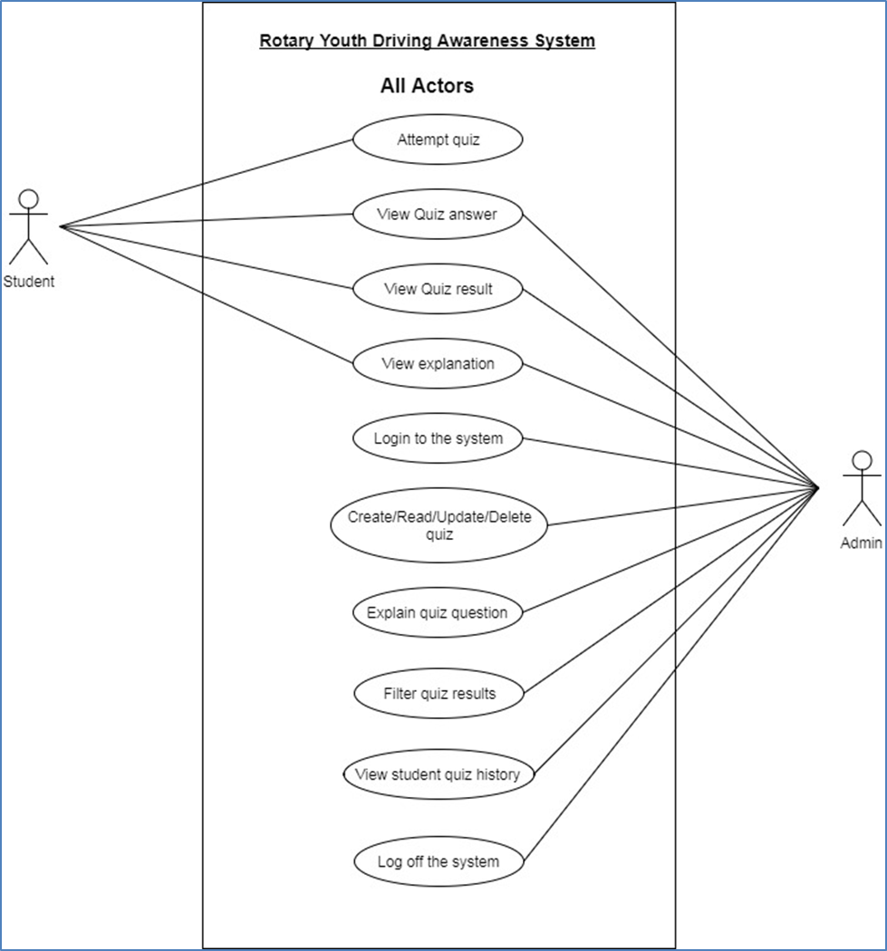
Use-cases

Slide 14
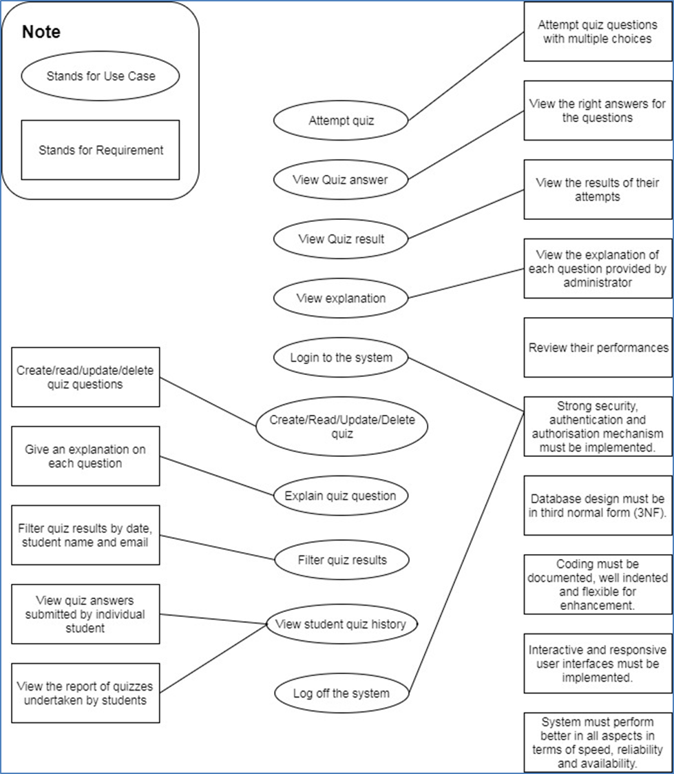
Mapping of requirements to use cases

Slide 15
RYDA Software architecture

Slide 16
RYDA MVC Layer Modelling

Slide 17
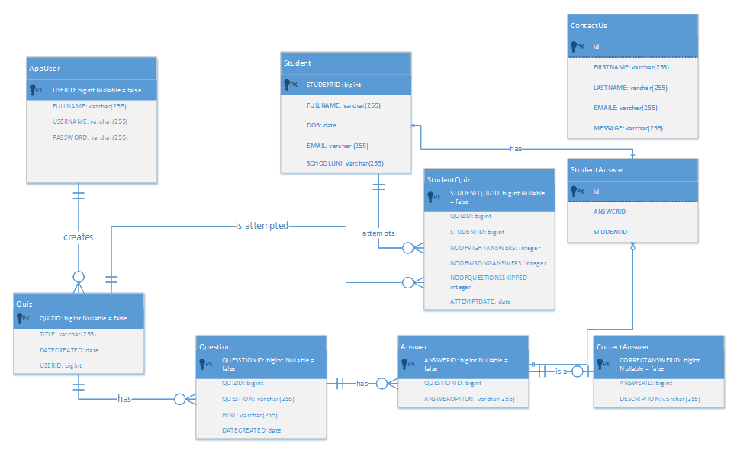
RYDA Entity Relationship Diagram

Slide 18
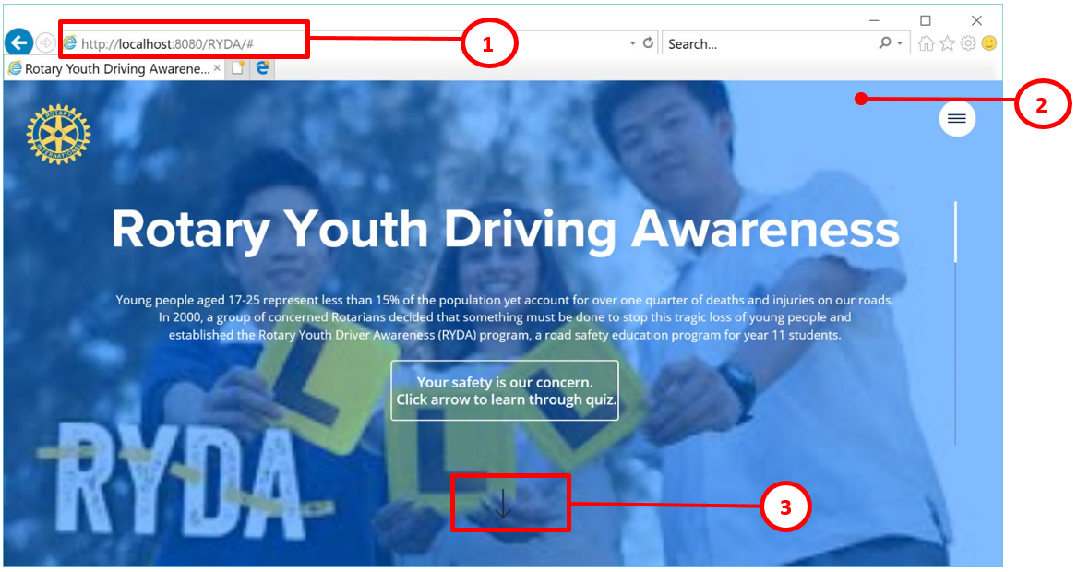
ryda User Interface (Home page)

Slide 19
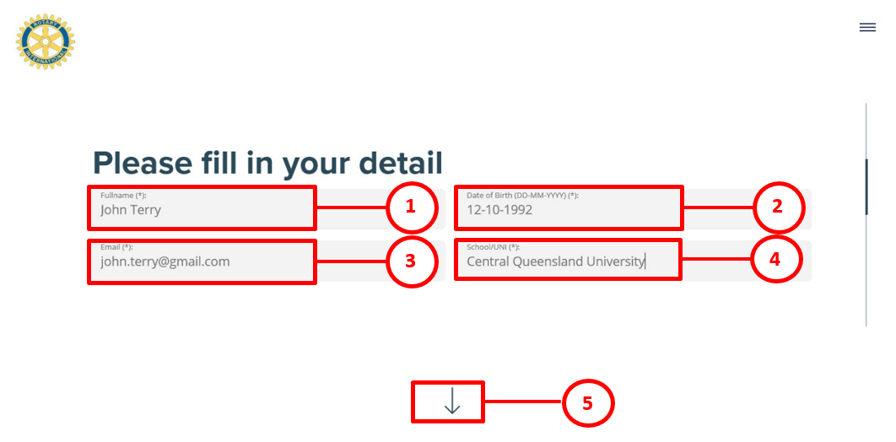
ryda User Interface (Personal detail form)

Slide 20
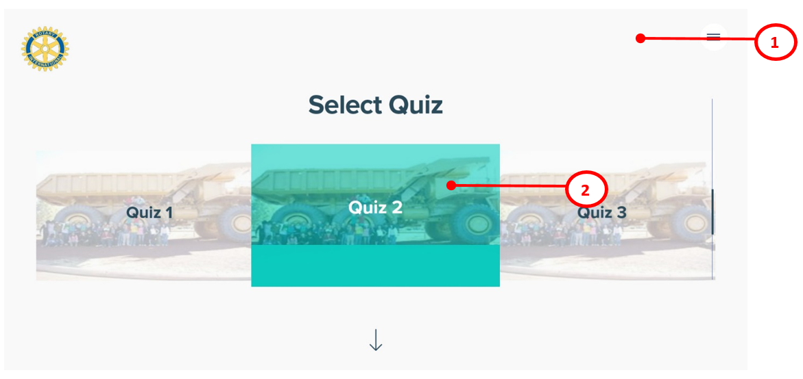
ryda User Interface (Quiz list)

Slide 21
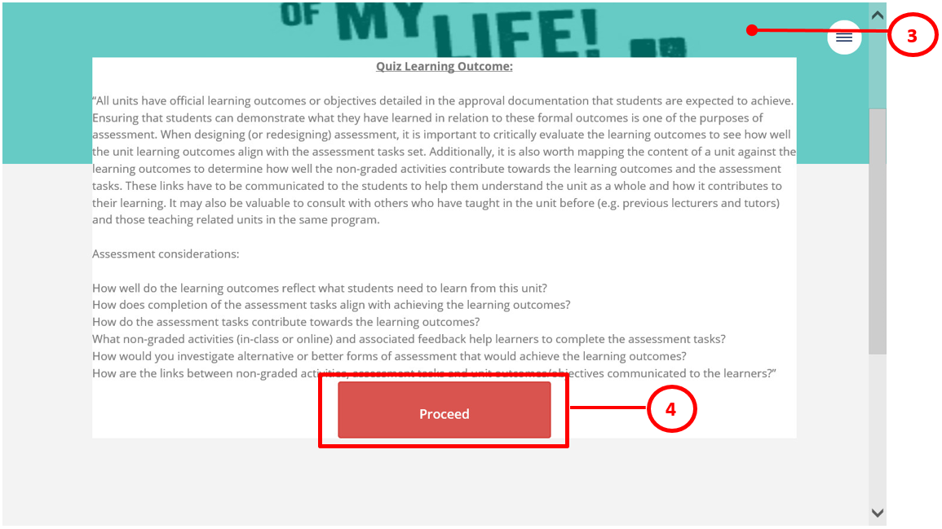
Quiz learning outcome

Slide 22
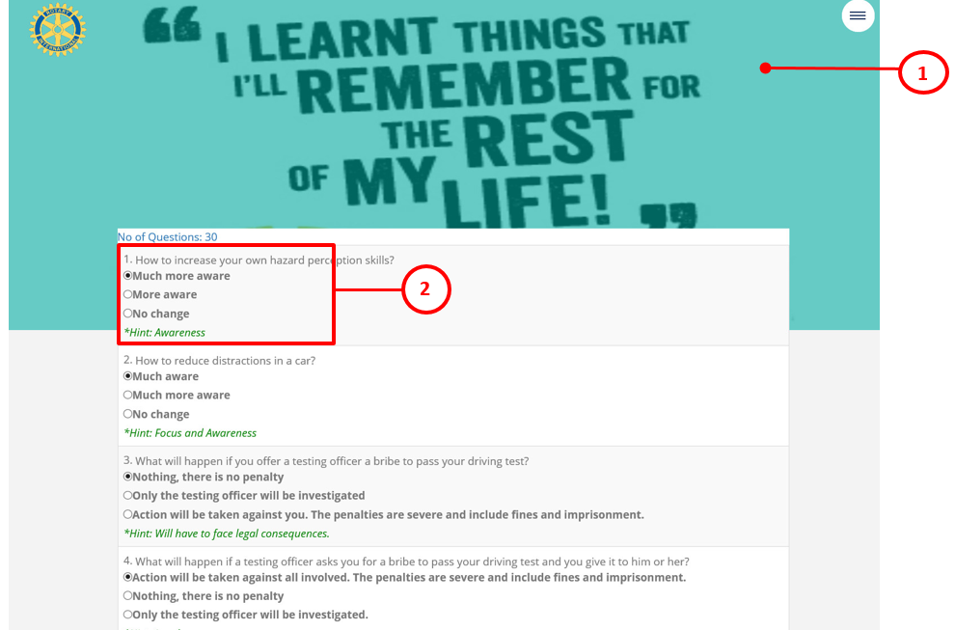
ryda User Interface (Quiz Questions)

Slide 23
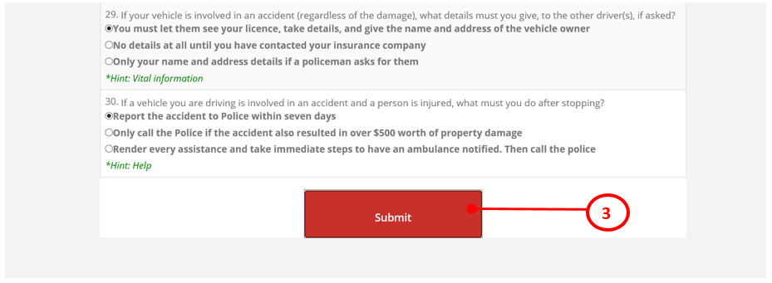
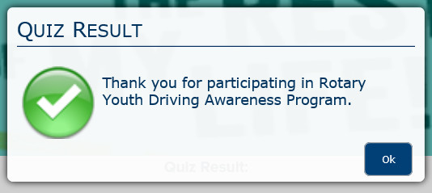
ryda User Interface (Quiz Questions) Continued.

Slide 24
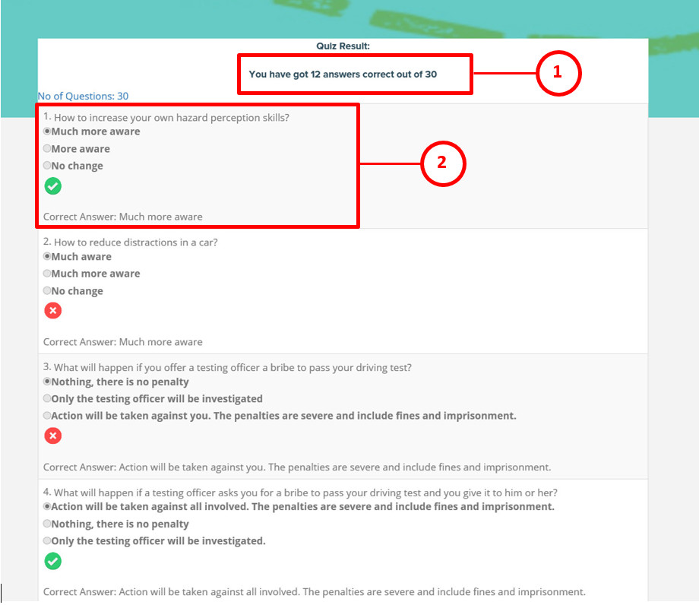
ryda User Interface (Quiz Answers with result)

Slide 25
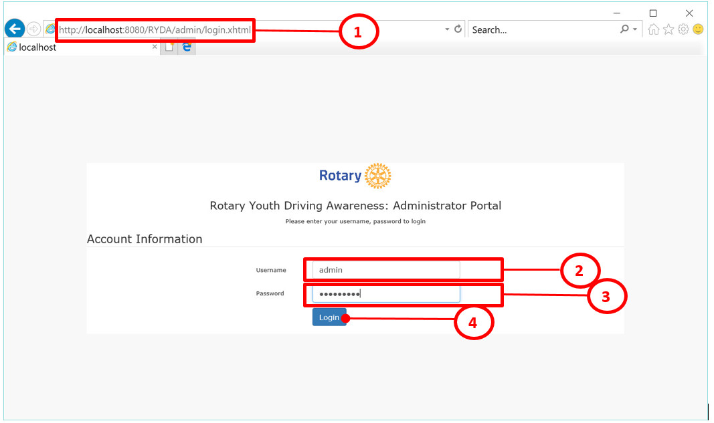
ryda User Interface (Admin Login form)

Slide 26
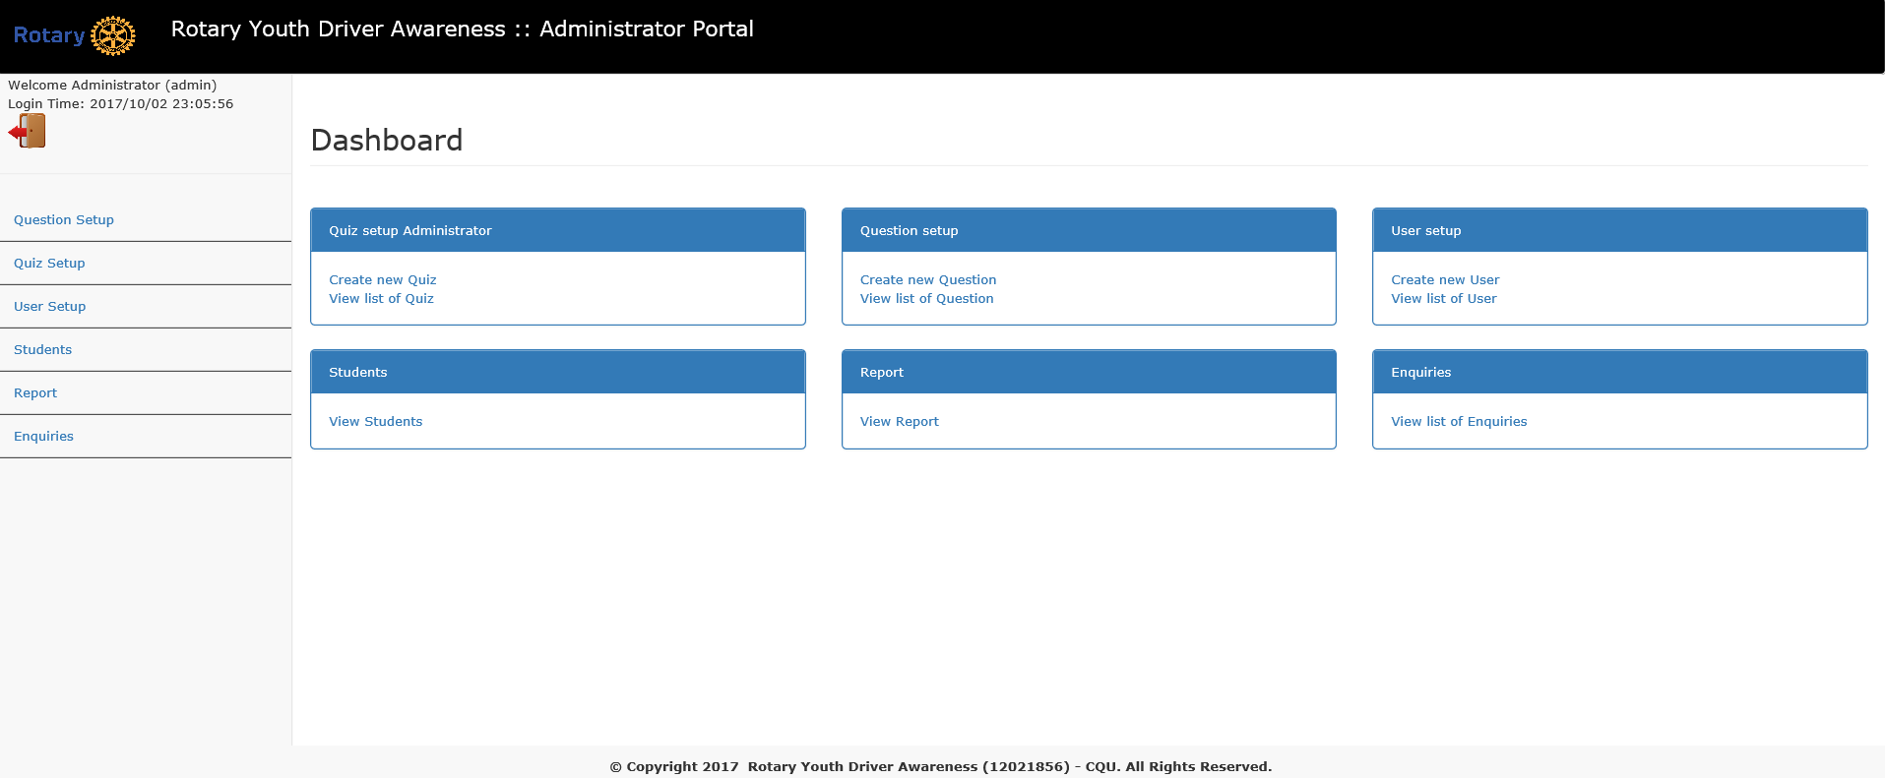
ryda User Interface (Admin Dashboard)

Slide 27
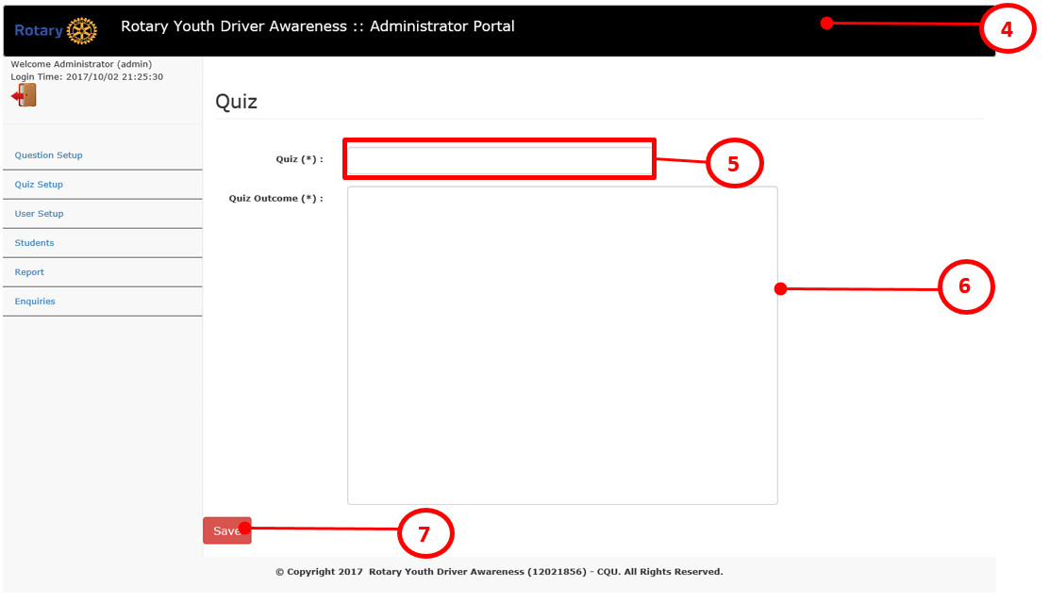
ryda User Interface (Admin Create Quiz)

Slide 28
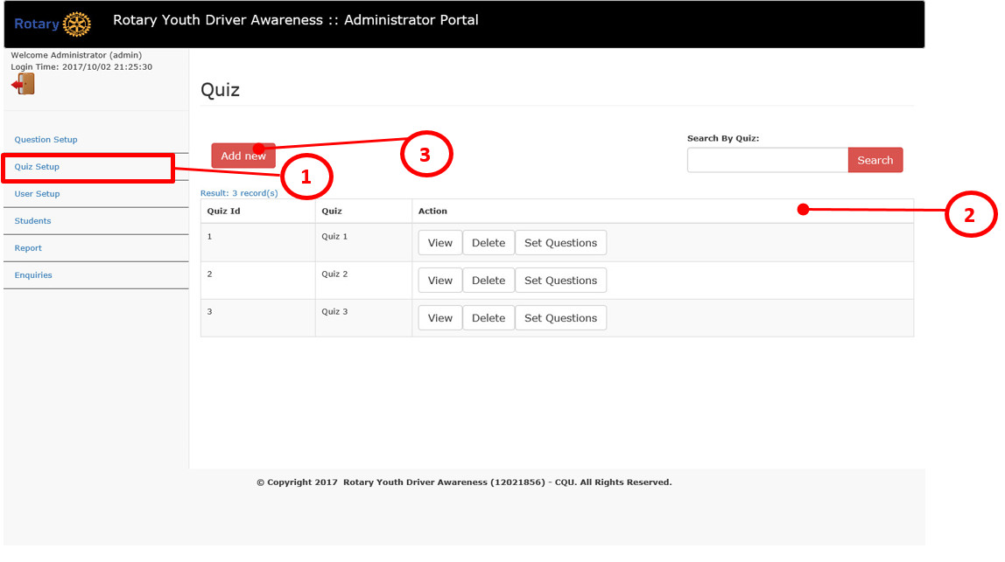
ryda User Interface (Admin Quiz List)

Slide 29
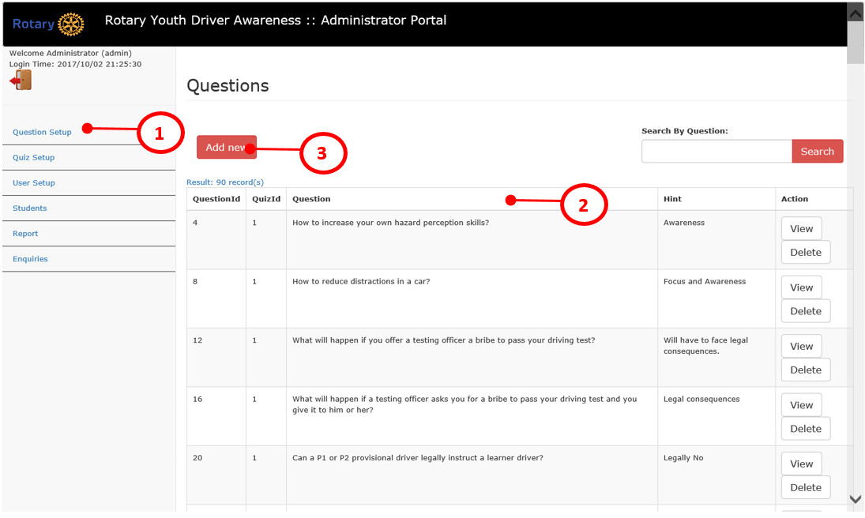
ryda User Interface (Admin Create questions list)

Slide 30
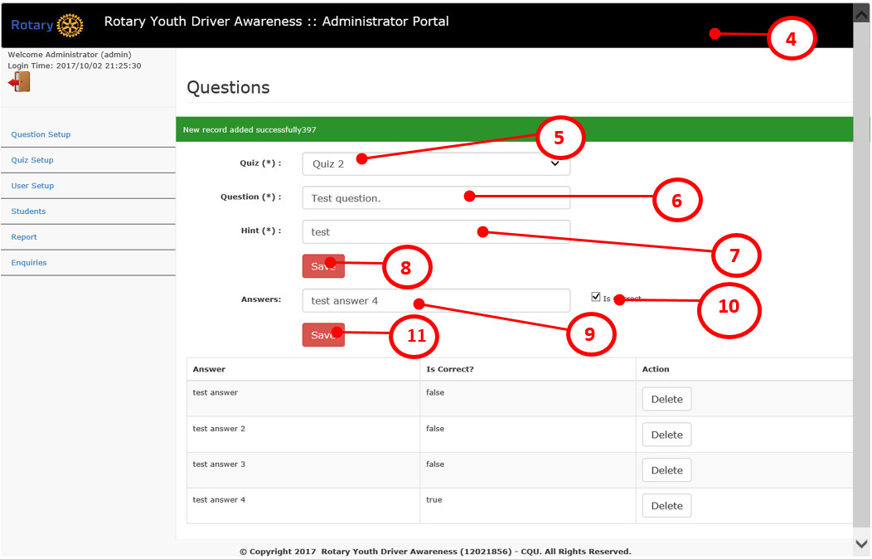
ryda User Interface (Admin Create questions and answers)

Slide 31
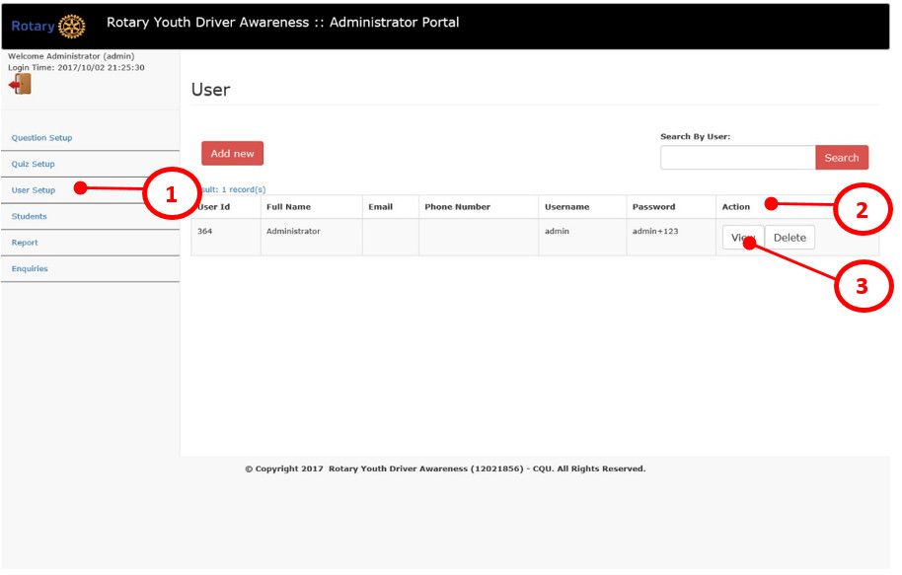
ryda User Interface (admin user List)

Slide 32
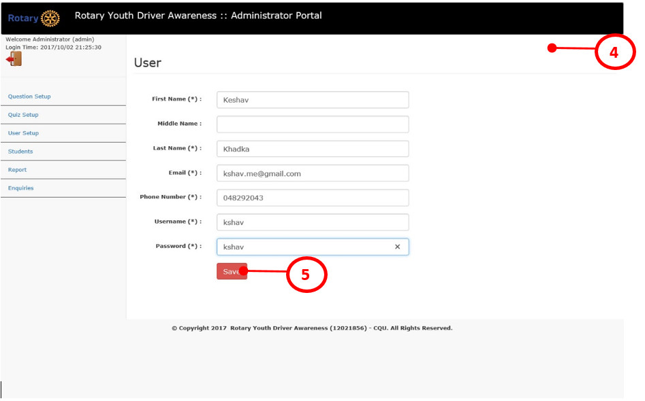
ryda User Interface (admin Create user)

Slide 33
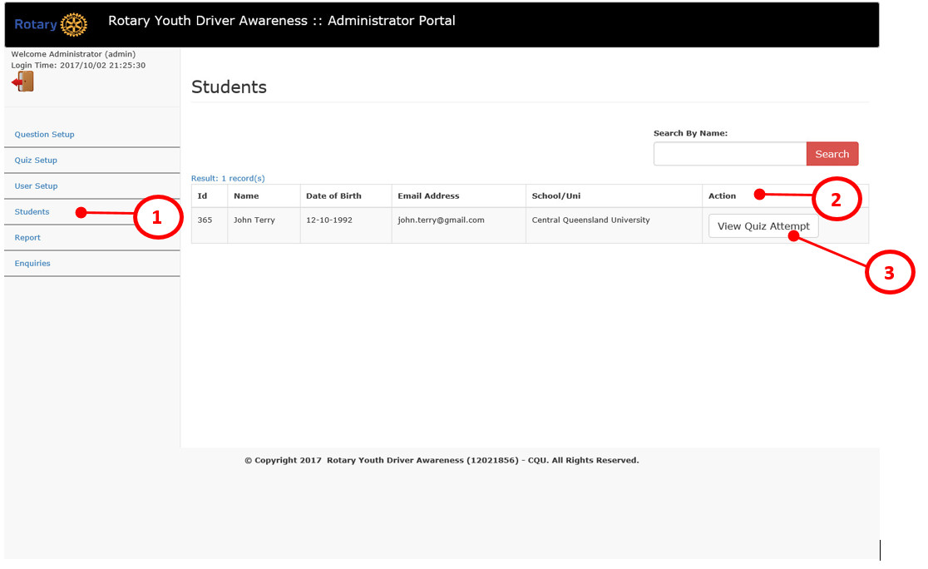
ryda User Interface (admin Student list)

Slide 34
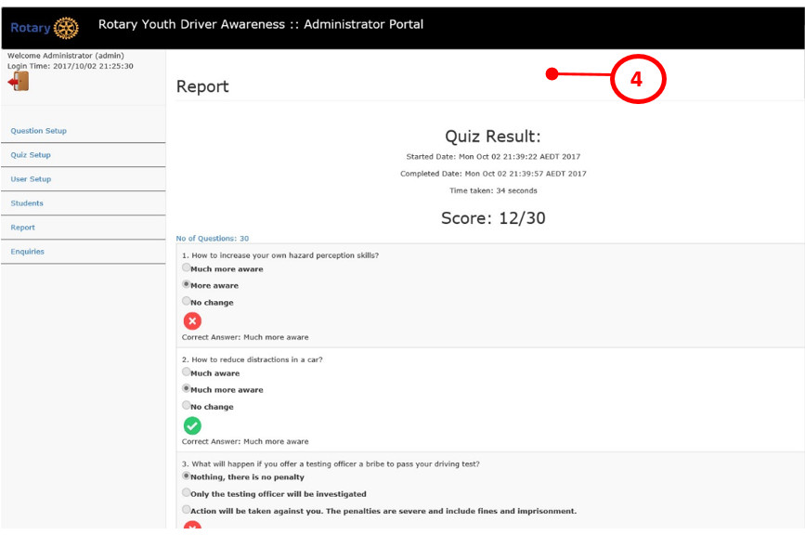
ryda User Interface (admin Individual attempt Report)

Slide 35
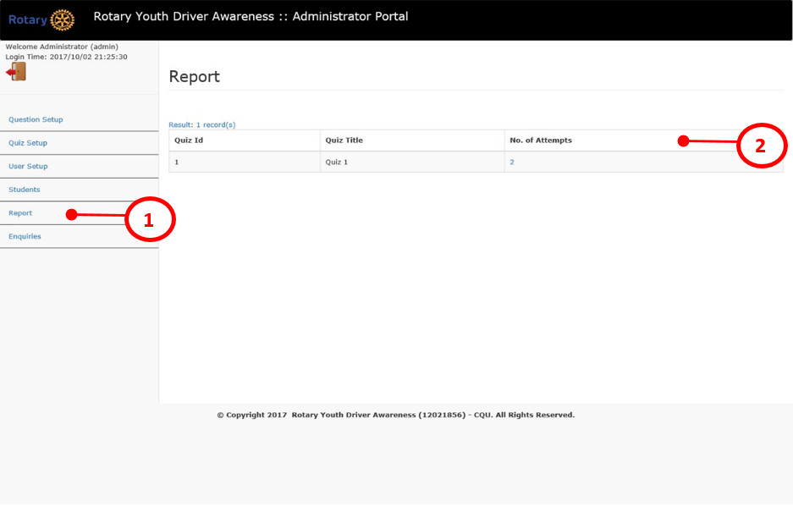
ryda User Interface (admin Quiz attempt Report list)

Slide 36
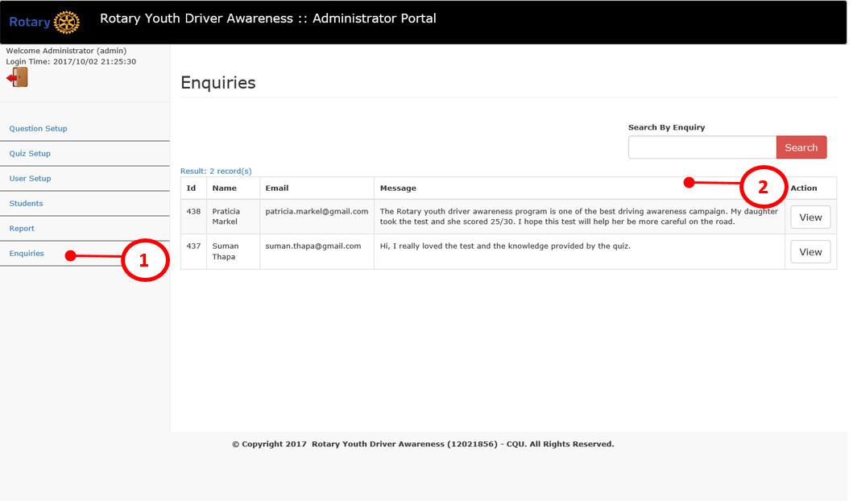
ryda User Interface (admin Quiz attempt Enquiries list)

Slide 37
Effort graph

Slide 38
Learnings
Project management skills
Leadership skills
Team work
Time management
Risk management
Quality management

Slide 39
Room for improvement
User interactivity can be improved
More statistical report on students and quiz attempts can be implemented
Graphical reporting can be implemented
Content Management System

Slide 40
Questions?

